Slide 1
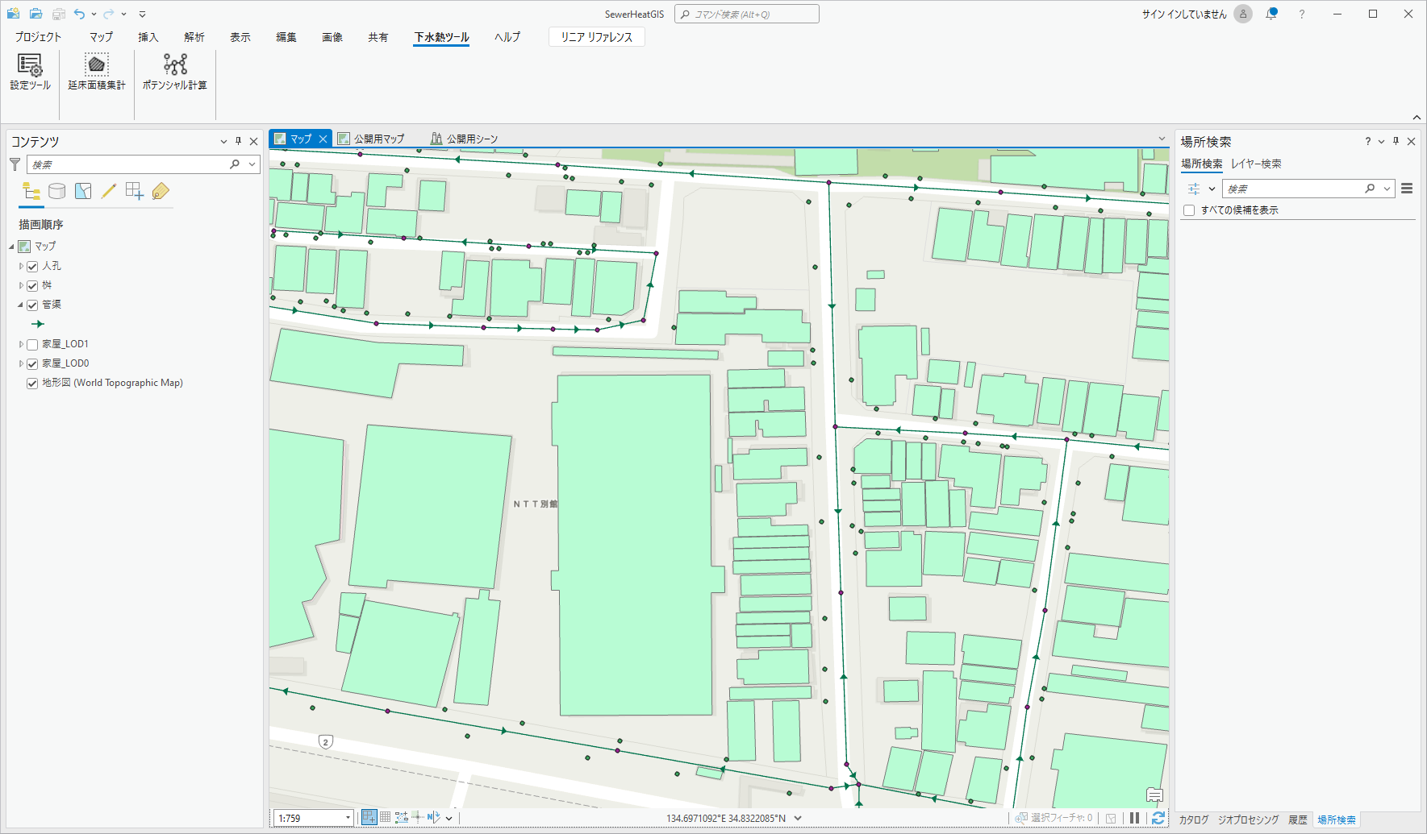
①
②
③

Slide 2
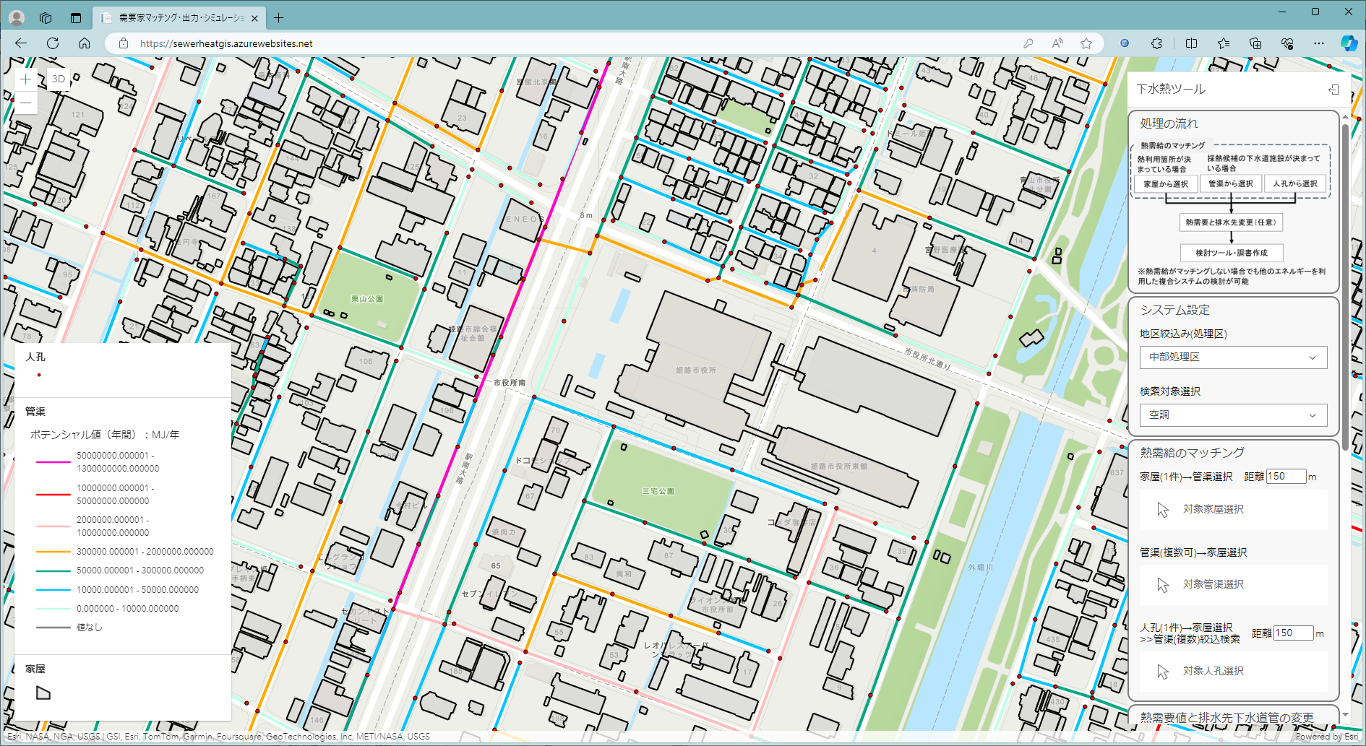
①
③
②

Slide 3
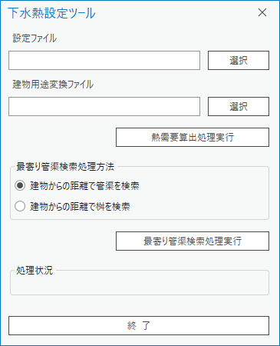
①
②
③
④
⑤
⑥

Slide 4
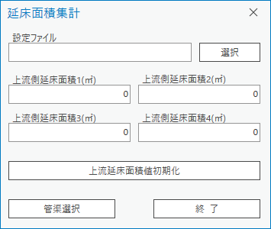
①
②
③
④
⑤
⑥
⑦
⑧

Slide 5
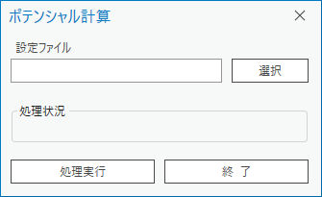
①
②
③

Slide 6
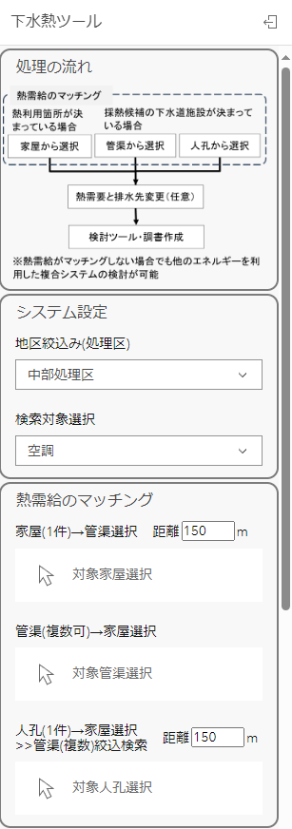
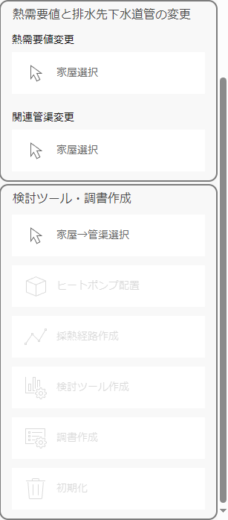
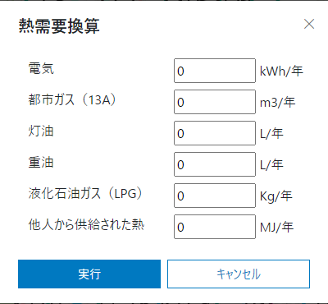
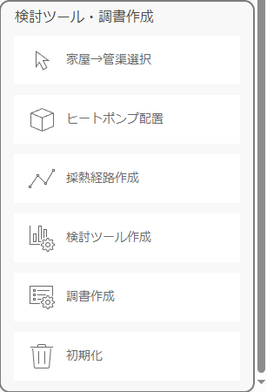
⑰
⑨
①
⑩
⑪
②
⑫
③
⑬
④
⑭
⑤
⑮
⑥
⑯
⑦
⑧

Slide 7
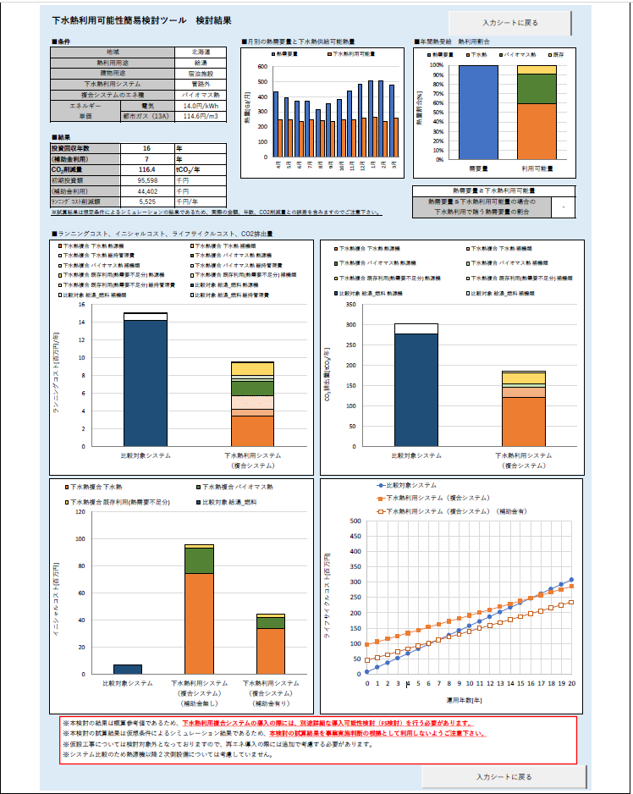

Slide 8
